Slide 1
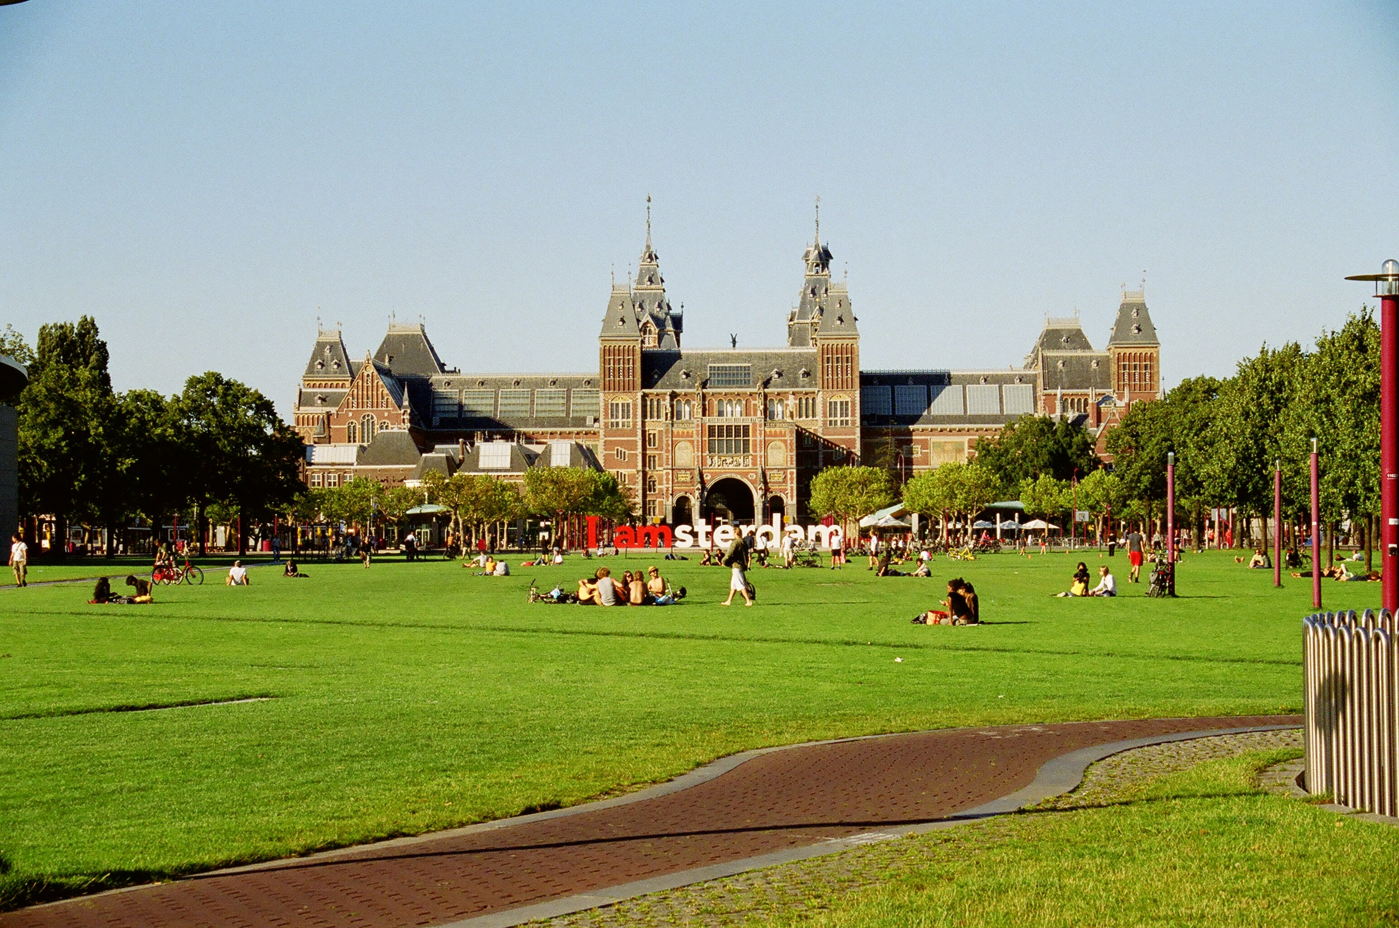
Are the people living in Amsterdam paying attention to waste less compare to the EU average based on yearly data?
If the conclusion to the first question is affirmative, what are the environmental initiatives for avoiding for zero waste in Amsterdam?

Slide 2
Household Waste
Data from 2012-2015
Area | Year | Separation percentage of total household waste [Percentage] | Total household waste presented [Kilos per inhabitant]
Amsterdam | 2012 | 13.00% | 433
Amsterdam | 2013 | 16.00% | 423
Amsterdam | 2014 | 17.00% | 427
Amsterdam | 2015 | 19.00% | 399
Amsterdam | Average | 16.25% | 420.5

Slide 3
Household Waste Category
Waste category | 2014 | 2015 | 2016 | 2017 | 2018
household residual waste | 287.1 | 278.8 | 256.3 | 250.1 | 244
bulky household waste | 56.3 | 38.8 | 66.2 | 63.9 | 68.8
renovation residual waste | 9.3 | 5.4 | 5.1 | 5.3 | 6
biodegradable waste | 0.7 | 0.5 | 0.5 | 0.7 | 0.5
wastepaper and cardboard | 27.1 | 26.6 | 22.5 | 21.3 | 20.7
packaging glass | 21 | 18.5 | 17.8 | 17.5 | 18
textile | 2.8 | 3.1 | 3.4 | 3.5 | 3.6
small toxic waste | 0.5 | 0.6 | 0.6 | 0.3 | 0.3
plastic packaging / PMD fraction | 1.7 | 2 | 2.6 | 3.1 | 3.5
discarded electrical and electronic appliances | 1.9 | 1.8 | 1.6 | 1.5 | 1.4
bulky garden waste | 2.7 | 3.5 | 4.3 | 1.6 | 1.5
metal | 0.8 | 0.8 | 0.8 | 0.8 | 0.9
wood waste (A and B wood) | 9.1 | 11.8 | 13.1 | 4.9 | 6.1
clean debris | 3.8 | 3.5 | 2.9 | 3.4 | 3.2
other waste | 2.1 | 3.1 | 0.9 | 2.8 | 2.7
Total household waste | 426.9 | 398.8 | 398.6 | 380.7 | 381

Slide 4
Average Household EU
Data from 2012-2016
European Union - 28 countries | Data from 2012 to 2016
Domestical waste | 507029594.4
Inhabitants | 1.629598e+08
Average waste per EU inhabitant | 321,401 kg
Average waste per Amsterdam inhabitant | 420,5 kg

Slide 5
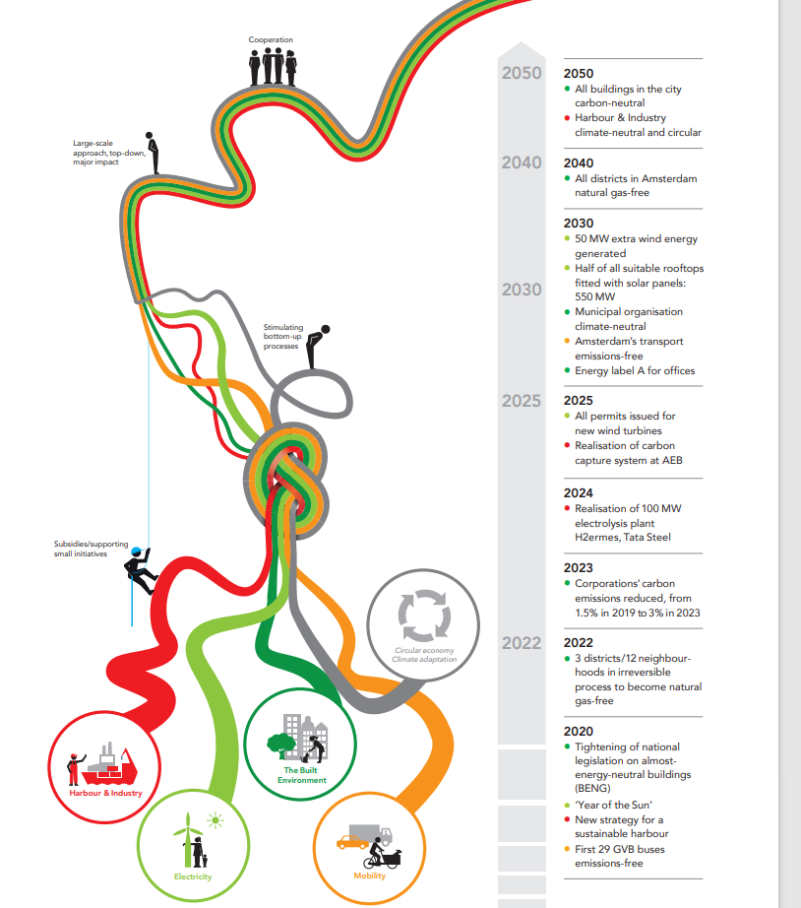
Vision of a Climate-Neutral Amsterdam in 2050
SOURCE: https://www.amsterdam.nl/bestuur-organisatie/werkmap/ons-beleid/ambities-uitvoeringsagenda-2019/gezonde-duurzame-stad/klimaatneutraal/

Slide 6
Improvements
Trend analysis would improve provided we had more raw data.
Also vision for a climate neutral Amsterdam is in the form of a vision and raw was not available at the time of project presentation.

Slide 7
THANK YOU
Any Questions?

